Slide 1
Polistudio
Davide Pezzolla, Giuseppe Piscopo, Maurizio Marseguerra

Slide 2

Is the study hall free?
Are there some near seats to study with my friends?
What if no tables are free?
How many seats are occupied?
Will I find a spot to sit?

Slide 3
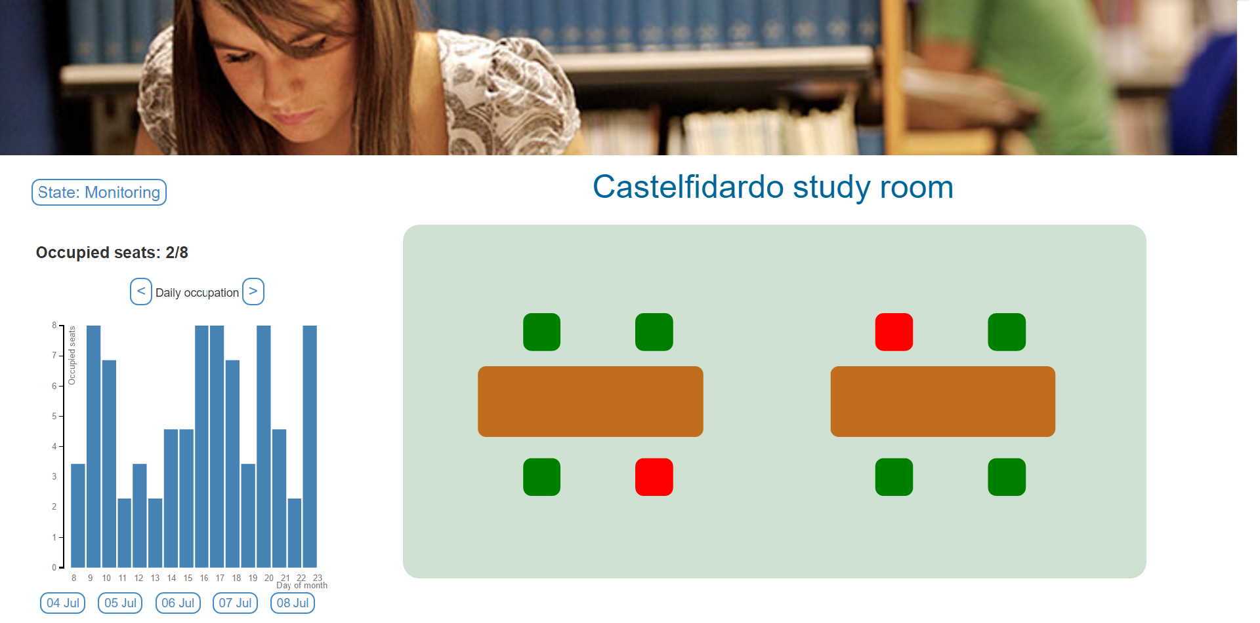
Polistudio is the solution!
It provides you an easy way to know which seats are available
in each monitored study hall.
You just have to connect to Polistudio web page in order to
get all the information you need!

Slide 4
Architecture

Slide 5
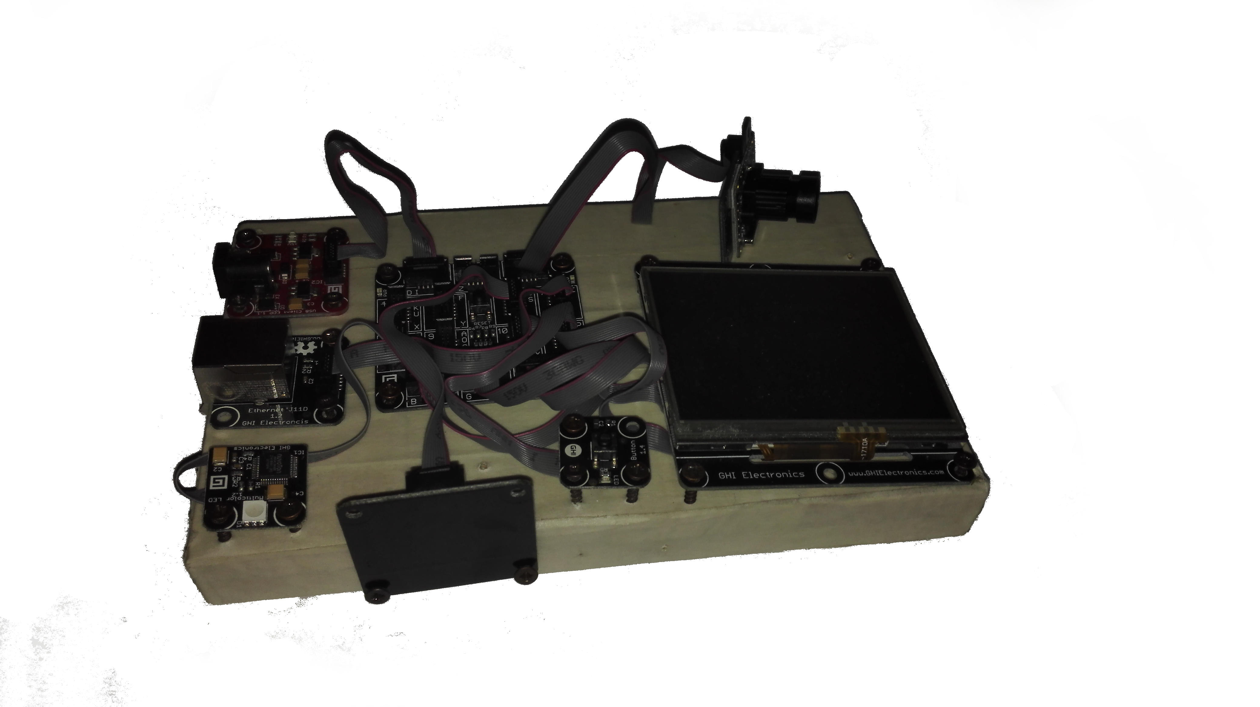
Gadgeteer - component
Camera
Ethernet module
Button
Multicolor LED
Display

Slide 6
Gadgeteer - features
Monitoring of a study hall
Communication with a web service (login, port request, logout)
Communication with a TCP server for image processing
Logging service through the
display and multicolor LED
Encrypted communication

Slide 7
Web service
It is a SOAP service application developed through WCF framework
It implements a sessionful communications associating a unique token to each client
It provides 3 operations:
Login: when successful it returns a randomly generated token
Port request: it starts a TCP server on a random port returning such a port to the client
Logout: it invalidates the client’s token
The communication is based on HTTPS

Slide 8
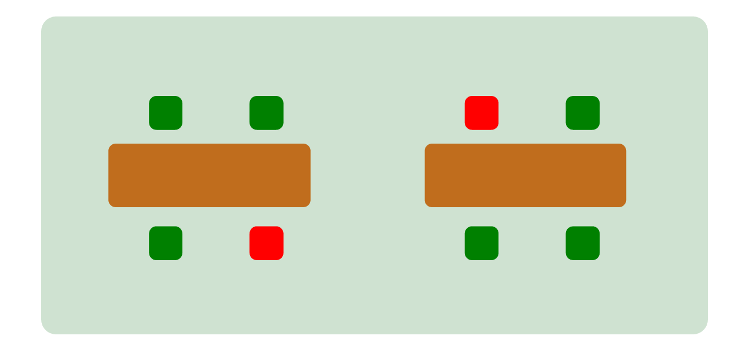
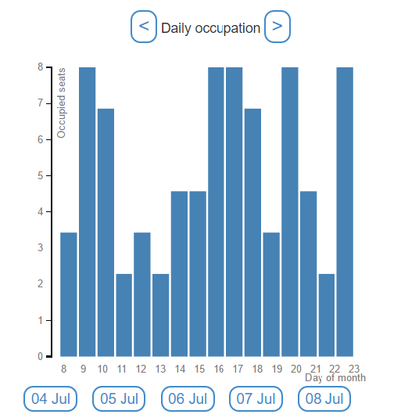
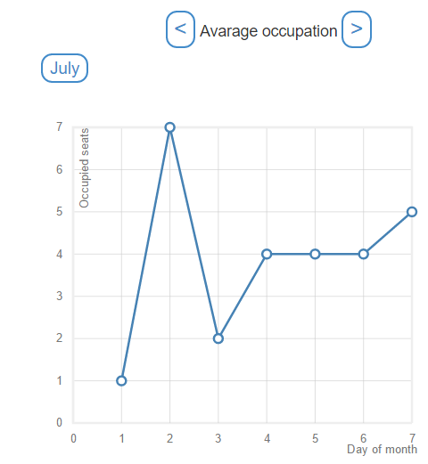
Web client
It is a web page application which represents real-time the information acquired and processed by the system:
Seats state information
Statistical information

Slide 9
Graphic processing – basic idea
The algorithm is based on the detection of groups of pixels with a known shape (BLOB)
BLOBs are detected by the difference between the analyzed frame and the empty room picture
A BLOB is interpreted as an occupied seat
Data persistency can not be managed by the graphic process because its life cycle ends after the processing of one picture
Graphic algorithm expects in input all the information about seats and tables collected into two different arrays, which modifies during its execution

Slide 10
Graphic processing - phases
Learning:
Discovery of tables and their coordinates exploiting a shaping analysis technique
Discovery of seats: for each BLOB detected into the analyzed picture if current_BLOB is not in seatsArray seatsArray.push(current_BLOB)
Monitoring:
Detection of seats state: for each seats retrieved from the learning phase if current_seat is in BLOBs detected_array current_seat = occupied else current_seat = free

Slide 11
Graphic processing – ghost seats
Problem During the learning phase the algorithm recognizes all the detected BLOB as a seat, hence walking people generate false positive that are considered as occupied seats
Solution Each time a seat x is found out, a counter x is incremented. At the end of the learning phase all the seats whose counter is less than a threshold are discarded

Slide 12
Graphic processing - limitation
Low camera resolution:
Some methods do not work well with a limited range of pixels
People too close may be detected as a single BLOB
Camera positioning:
Some objects may block the view of close spots generating false positive
It can be solved positioning the camera perpendicularly to the ground
Light:
The algorithm is sensitive to the actual light condition
It requires the manually configuration of some parameters
It can be solved with the deployment of a light sensor

Slide 13
Use case – sending of the image to the server TCP with initial set up

Slide 14
Use case – information detection from picture

Slide 15
Use case – client notification

Slide 16
Security
Username and password authentication
Encrypted communication with web service
TCP communication unencrypted because of performance issue

Slide 17
Thanks for your attention

